Slide 1
Learning Spark
丁廷鹤

Slide 2
Preface
Easy use
Fast
General engine

Slide 3
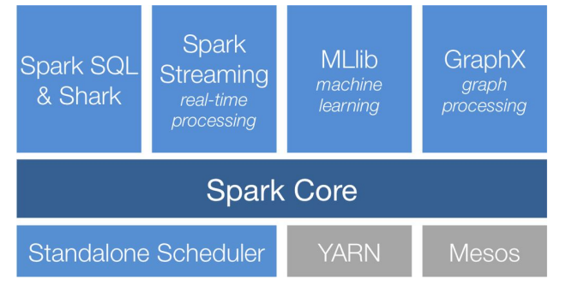
Stack

Slide 4

Spark core

Slide 5
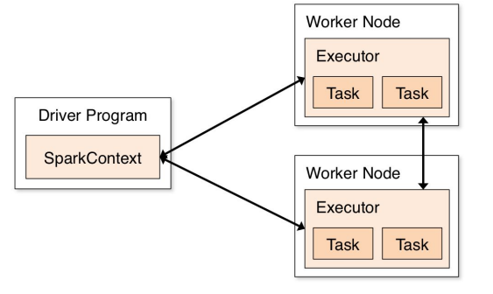

Slide 6


Slide 7




Slide 8



Slide 9



Slide 10
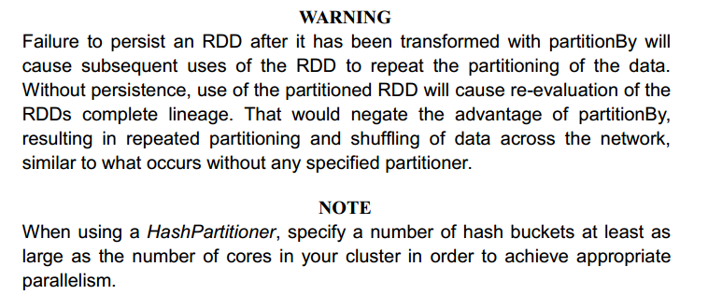

Slide 11

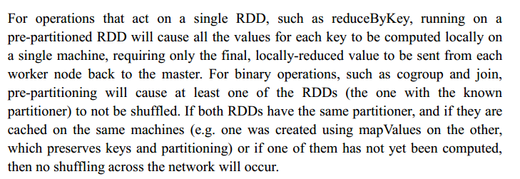

Slide 12
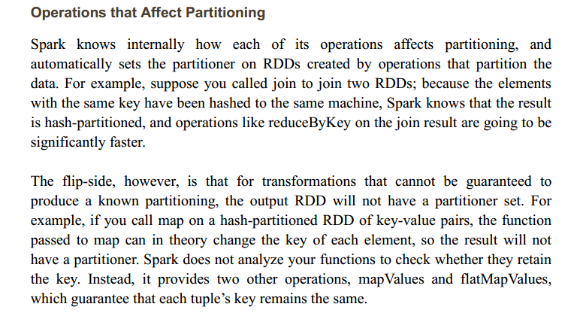

Slide 13
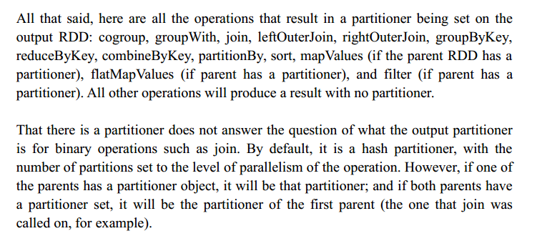


Slide 14


